Slide 1
Rice University Data Analytics and visualization Bootcamp
PROJECT 1
TITLE: The Impact of Covid-19 on Suicide Rate
Group Members: Armine Arutyunyan
Birundha Varatharajan
Ammanesi Adamu
Stan Ejiobi

Slide 2
Introduction
Covid-19, a world pandemic which broke out in late 2019 brought significant changes to the world. Despite its direct impact on sickness and mental health around the world, its effect was also felt on suicide rate.

Slide 3
Scope
The goal of this project is:
To examine the impact of Covid-19 on suicide rate. The task includes gathering information on global suicide rate and recorded Covid-19 cases.
The information will be broken down using different strategies to identify and point out any patterns.

Slide 4
Data Source
Data was pulled form the following sources to capture suicidal trends as impacted by Covid-19.
Name of website(Website url)
Name of website(Website url)
World Bank (www.worldbank.org)
API
http://api.worldbank.org/v2

Slide 5
Methods
Data was pulled directly from 3 files containing suicide data dating back to the 1960s.
Imported to pandas
Cleaned
Irrelevant columns dropped
Data frames created.

Slide 6
Observation
Name of website(Website url) showed that ……………
Name of website(Website url) showed that ……………
Name of website(Website url) showed that ……………

Slide 7
4 Questions to Address
Global Suicide Rate (2016 to 2020) ?
Global Suicide Rate by Age group (2016 to 2020) ?
Global Suicide Rate by Gender (2016 to 2020) ?
United States Suicide Rate (2005 to 2021)

Slide 8
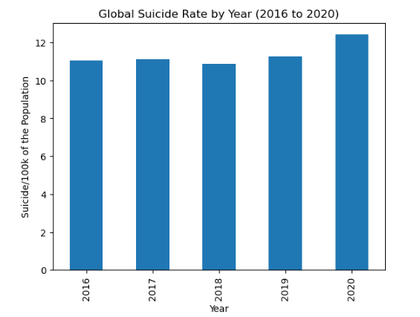
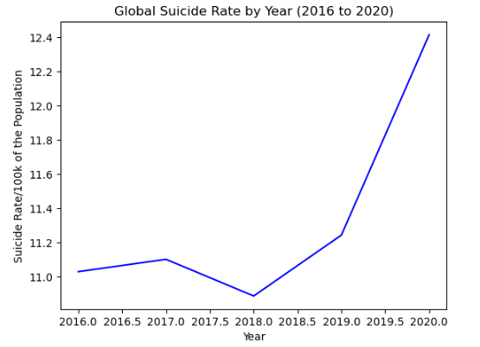
Results
A five-year span was examined globally from 2016 to 2020
The suicide rate was observed to be steady from 2016 to 2019
There was a sharp increase in 2020, which is suspected to be linked to the effects of Covid-19

Slide 9
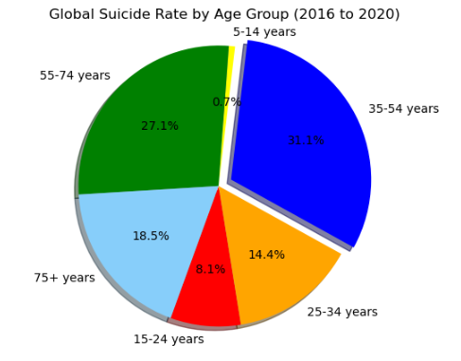
Results Continued …
By Age
A five-year span was examined globally from 2016 to 2020
The largest group to be affected were the 35 to 54 years age group.
Can we edit this pie chart to show 2016 to 2020?

Slide 10
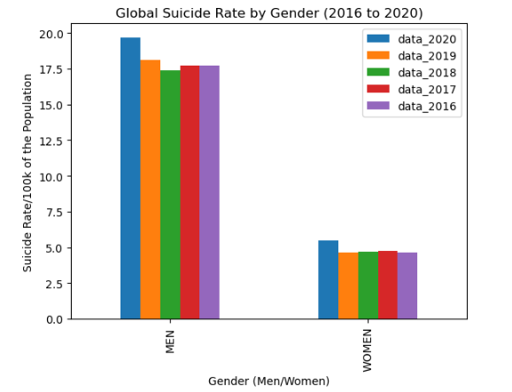
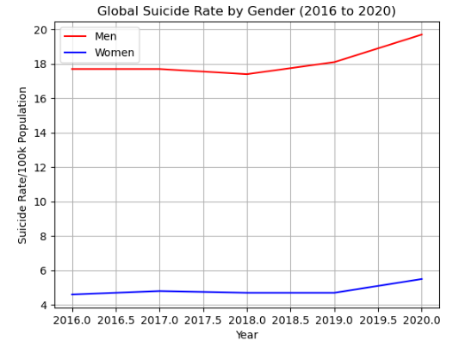
Results Continued ….
By Gender
A five-year span was examined globally from 2016 to 2020
The suicide rate was observed to be steady from 2016 to 2019
There was a sharp increase in 2020, which is suspected to be linked to the effects of Covid-19

Slide 11
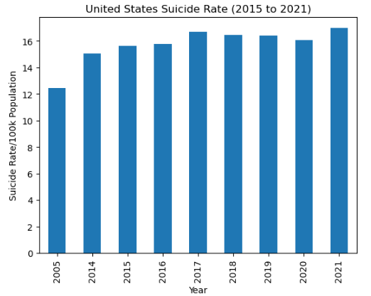
Results Continued….
United States
A nine-year span was examined in the United States from 2013 to 2021
The suicide rate increased and fluctuated till from 2013 till 2019, decreased in 2020 and increased in 2021.
The changes in 2020 and 2021 do not suggest that Covid-19 impacted suicide rates in the United States.

